Slide 1
Solving torsion problem using integration
G12
Numercial Analysis

Slide 2
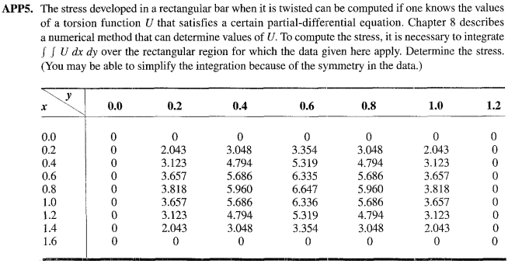
The problem

Slide 3
The domain of the problem

Slide 4
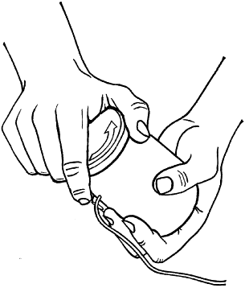
Stress
Why do we need to calculate stress?
In order to have a perfect perception of stress we have to know the importance of stress and whether we deal with it in our real life, the following two examples will illustrate this: The first example, picture a traffic sign mounted on a single column on a windy day, the wind causes the sign to twist, and this twist causes shear stress which a type of stress we will discuss later in this section. The second example, when we open a thin jar, we actually use our hands to apply a force equal in magnitude and opposite in direction over the jar. The question here how much force need to apply until open it without broken. In the mechanics of material, they consider all bodies are deformable and those applied external force generate internal stress. Calculating stress will prevent this problem from appearing.

Slide 5
Types of stress
In physics, there are various types of stress, however they are divided into two main types: Normal Stress and Tangential or Shearing Stress. The next paragraphs go over some of the many forms of stress.
1. Normal Stress:
When the direction of the deforming force is perpendicular to the cross-sectional area of the body, stress is said to be normal stress. The stress will be normal as the wire length, or the body volume varies.
Normal stress is further divided into two subcategories based on the force dimension.
Longitudinal stress
Bulk Stress or Volumetric stress

Slide 6
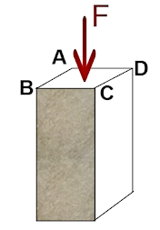
In physics, there are various types of stress, however they are divided into two main types: Normal Stress and Tangential or Shearing Stress. The next paragraphs go over some of the many forms of stress.
1. Normal Stress:
When the direction of the deforming force is perpendicular to the cross-sectional area of the body, stress is said to be normal stress. The stress will be normal as the wire length, or the body volume varies.
Normal stress is further divided into two subcategories based on the force dimension.
Longitudinal stress
Bulk Stress or Volumetric stress

Slide 7
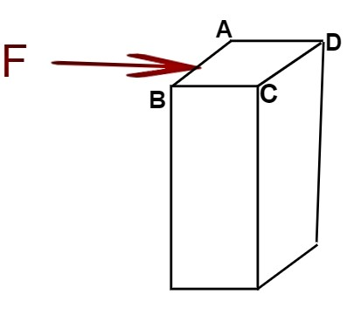
2. Shearing Stress or Tangential Stress:
when the force acts parallel to the item's surface area. The stress created in the object is called shear stress or tangential stress. It results in changing the shape of the body.
As shown in the diagram, the force F acts parallel to the surface area ABCD, causing shear stress to form in the item.

Slide 8
The methods

Slide 9
01
The Trapezoidal Rule

Slide 10
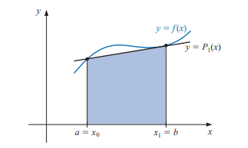
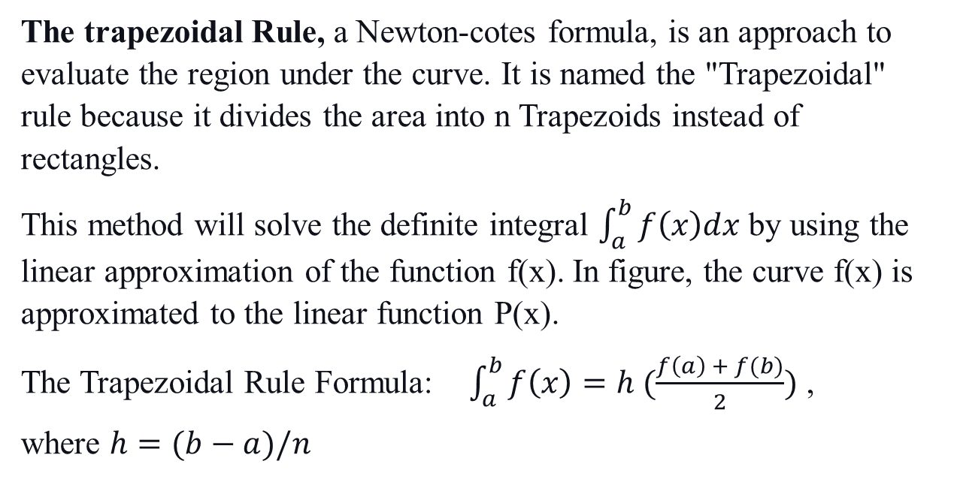
The trapezoidal Rule, a Newton-cotes formula, is an approach to evaluate the region under the curve. It is named the "Trapezoidal" rule because it divides the area into n Trapezoids instead of rectangles.
This method will solve the definite integral $\int_{a}^{b}{f\left(x\right)dx}$ by using the linear approximation of the function f(x). In figure, the curve f(x) is approximated to the linear function P(x).
The Trapezoidal Rule Formula: $\int_{a}^{b}{f\left(x\right)=h (\frac{f\left(a\right) + f(b)}{2})}$ ,
where $h=(b−a)/n$

Slide 11
Advantages | Disadvantages
a fast and simple approach that use in numerical integration | The rate of convergence is low. We need more number of subspaces to get more accurate results.
Uses in piecewise linear curves | trapezoidal rule gives an inaccurate results. In the decreasing gradient of any graph trapezoidal method gives an underestimate, while for an increasing gradient, it will give an overestimate
Uses in many functions such as double exponential functions , periodic functions etc...

Slide 12
02
Simpson’s Rule

Slide 13
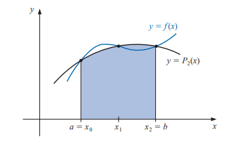
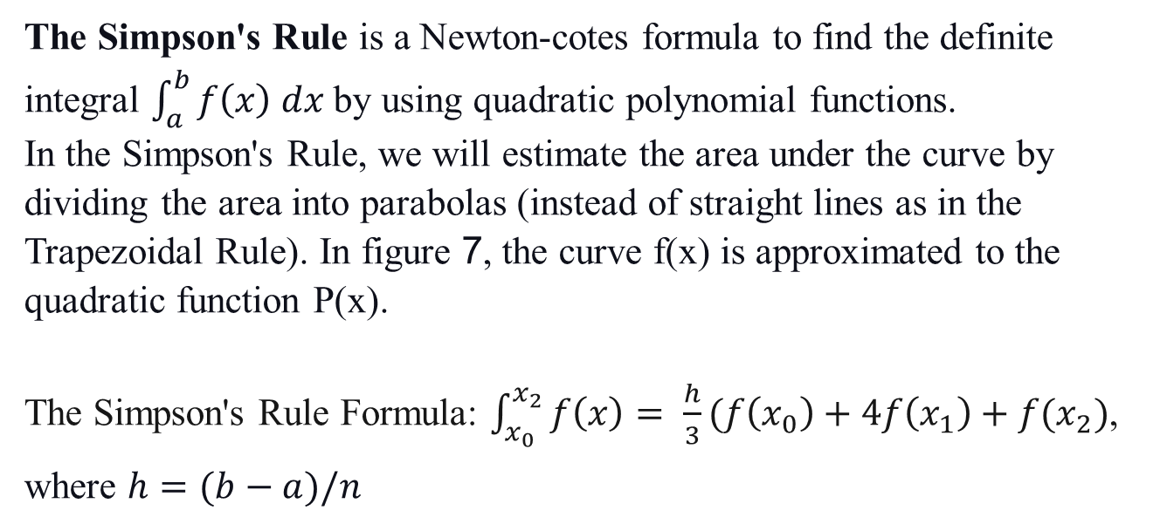
The Simpson's Rule is a Newton-cotes formula to find the definite integral $\int_{a}^{b}{f\left(x\right) dx}$ by using quadratic polynomial functions.
In the Simpson's Rule, we will estimate the area under the curve by dividing the area into parabolas (instead of straight lines as in the Trapezoidal Rule). In figure 7, the curve f(x) is approximated to the quadratic function P(x).
The Simpson's Rule Formula: $\int_{x_{0}}^{x_{2}}{f\left(x\right)= \frac{h}{3}(f\left(x_{0}\right)+4f\left(x_{1}\right)+f(x_{2})}$,
where $h=(b−a)/n$

Slide 14
Advantages | Disadvantages
More accurate than the trapezoidal rule | the number of finite intervals between the limits in Simpson's rule is must be an even number
Works well in curves | Composite Simpson’s rule needs a lot of math! it is easy to integrate quadratic equations by integrate the quadratic equation over the intervals. It ends with a very accurate approximation, but it is also needs a lot of math!
Uses when the underlying function is smooth and its use quadratic approximations so that’s why its has a smaller error.

Slide 15
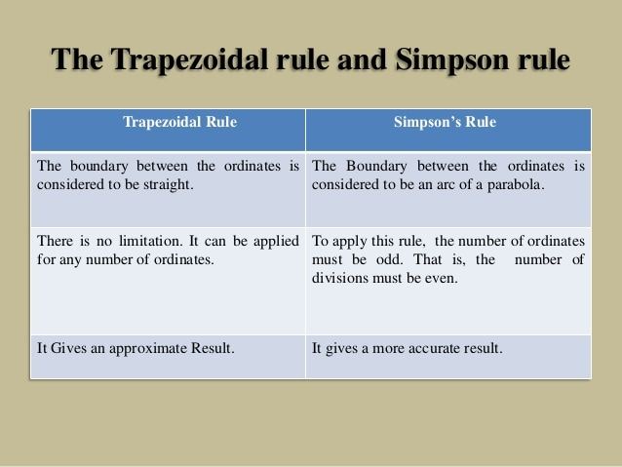
the difference between Tapzoidal Rule and Simpson’s Rule

Slide 16
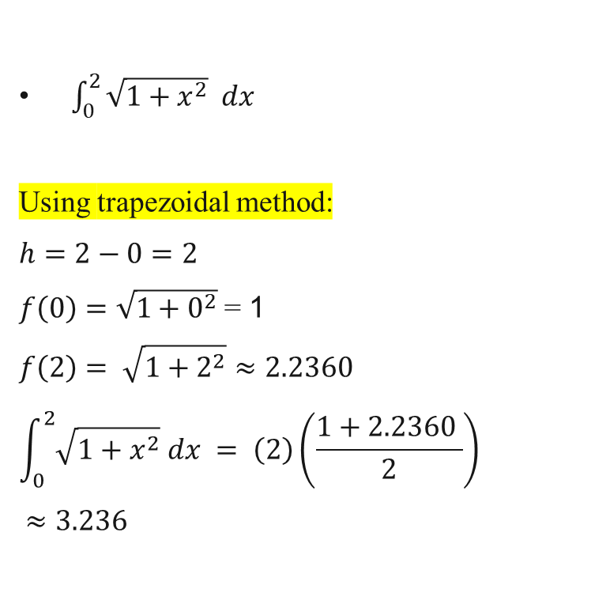
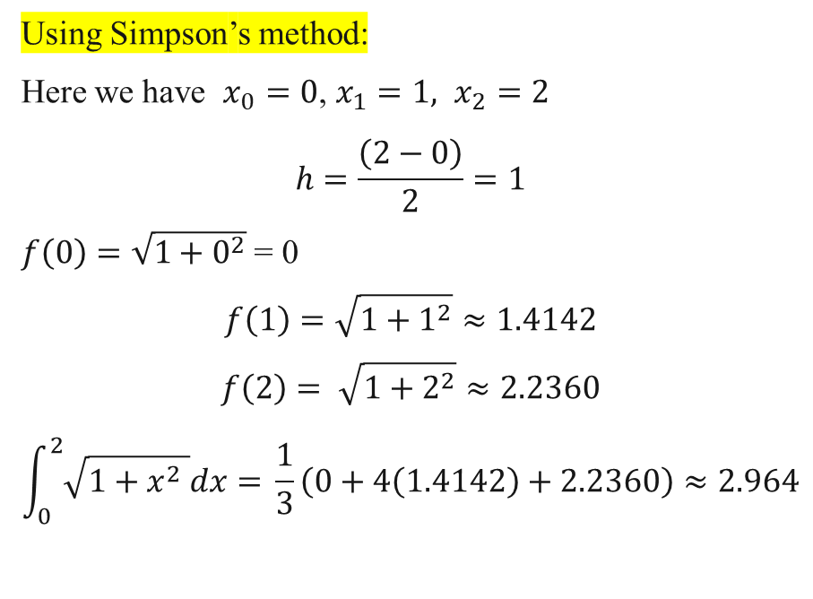
Example
$\int_{0}^{2}{\sqrt{1+x^{2}} dx}$
Using trapezoidal method:
$$h=2−0=2$$
$f\left(0\right)=\sqrt{1+0^{2}}$ = 1
$$f\left(2\right)= \sqrt{1+2^{2}}≈2.2360$$
$$\int_{0}^{2}{\sqrt{1+x^{2}} dx} = \left(2\right)\left(\frac{1+2.2360 }{2}\right)$$
$$≈3.236$$
Using Simpson’s method:
Here we have $x_{0}=0$, $x_{1}=1,$ $x_{2}=2$
$$h=\frac{\left(2−0\right)}{2}=1$$
$f\left(0\right)=\sqrt{1+0^{2}}$ = 0
$$f\left(1\right)=\sqrt{1+1^{2}}≈1.4142$$
$$f\left(2\right)= \sqrt{1+2^{2}}≈2.2360$$
$$\int_{0}^{2}{\sqrt{1+x^{2} }dx= }\frac{1}{3}\left(0+4\left(1.4142\right)+2.2360\right)≈2.964$$

Slide 17
How to solve our problem ?

Slide 18
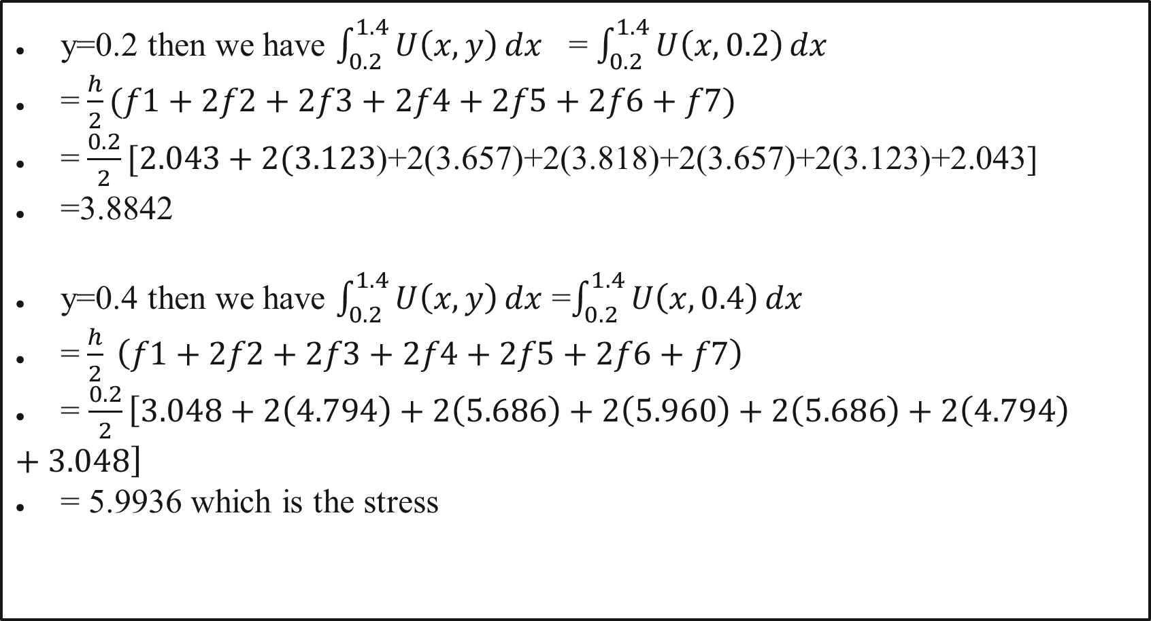
y=0.2 then we have $\int_{0.2}^{1.4}{U\left(x,y\right)dx}$ = $\int_{0.2}^{1.4}{U\left(x,0.2\right)dx}$
=$\frac{h}{2}(f1+2f2+2f3+2f4+2f5+2f6+f7)$
=$\frac{0.2}{2}[2.043+2(3.123$)+2(3.657)+2(3.818)+2(3.657)+2(3.123)+2.043]
=3.8842
y=0.4 then we have $\int_{0.2}^{1.4}{U\left(x,y\right)dx}$ =$\int_{0.2}^{1.4}{U\left(x,0.4\right)dx}$
=$\frac{h}{2} \left(f1+2f2+2f3+2f4+2f5+2f6+f7\right)$
= $\frac{0.2}{2}\left[3.048+2\left(4.794\right)+2\left(5.686\right)+2\left(5.960\right)+2\left(5.686\right)+2\left(4.794\right)+3.048\right]$
= 5.9936 which is the stress

Slide 19
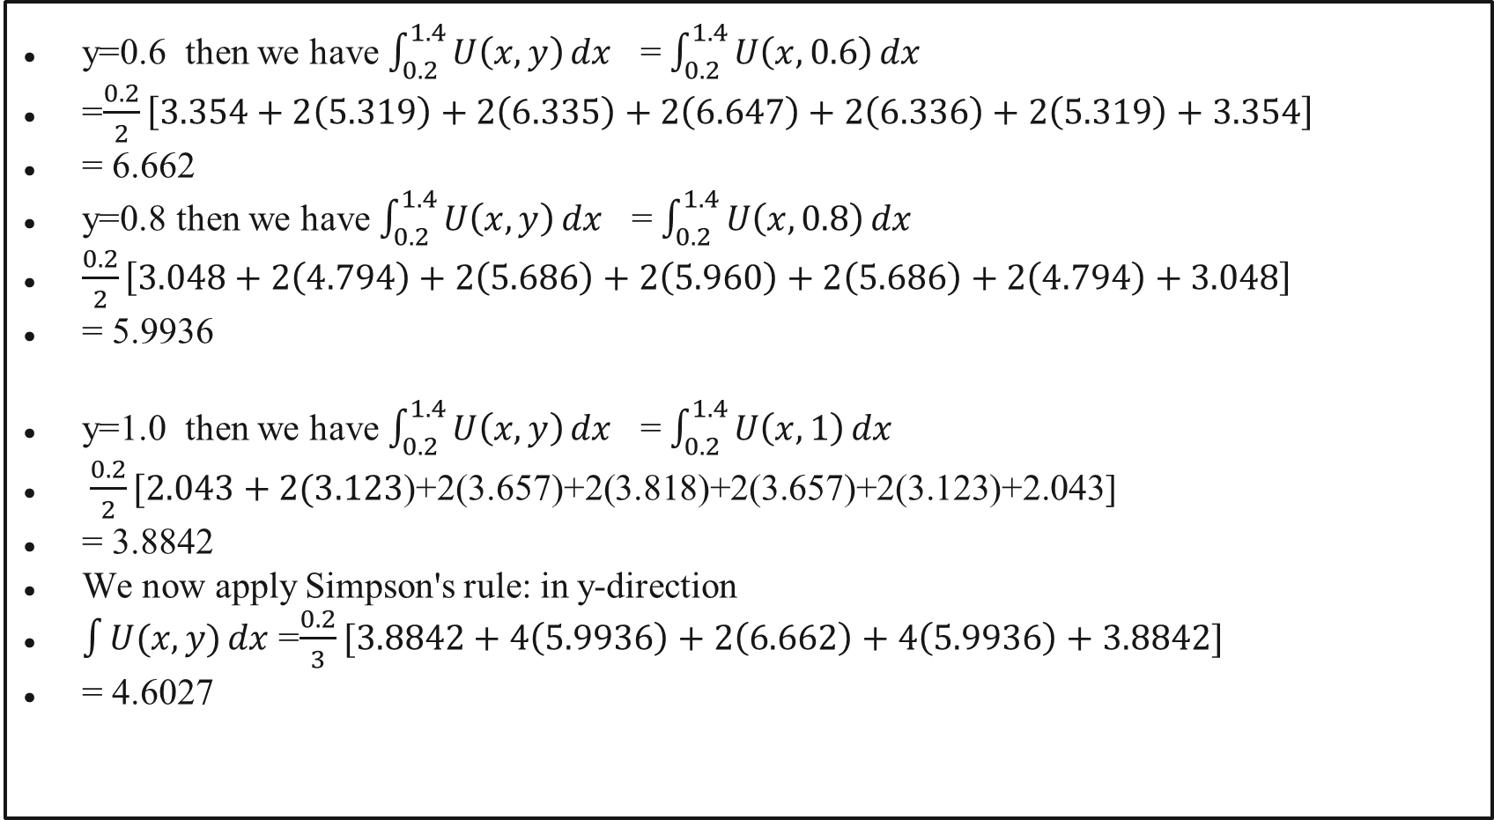
y=0.6 then we have $\int_{0.2}^{1.4}{U\left(x,y\right)dx}$ = $\int_{0.2}^{1.4}{U\left(x,0.6\right)dx}$
=$\frac{0.2}{2}\left[3.354+2\left(5.319\right)+2\left(6.335\right)+2\left(6.647\right)+2\left(6.336\right)+2\left(5.319\right)+3.354\right]$
= 6.662
y=0.8 then we have $\int_{0.2}^{1.4}{U\left(x,y\right)dx}$ = $\int_{0.2}^{1.4}{U\left(x,0.8\right)dx}$
$\frac{0.2}{2}\left[3.048+2\left(4.794\right)+2\left(5.686\right)+2\left(5.960\right)+2\left(5.686\right)+2\left(4.794\right)+3.048\right]$
= 5.9936
y=1.0 then we have $\int_{0.2}^{1.4}{U\left(x,y\right)dx}$ = $\int_{0.2}^{1.4}{U\left(x,1\right)dx}$
$\frac{0.2}{2}[2.043+2(3.123$)+2(3.657)+2(3.818)+2(3.657)+2(3.123)+2.043]
= 3.8842
We now apply Simpson's rule: in y-direction
$\int{U(x,y)dx}$ =$\frac{0.2}{3}[3.8842+4\left(5.9936\right)+2\left(6.662\right)+4\left(5.9936\right)+3.8842]$
= 4.6027

Slide 20
Thank you !

